Slide 1
AMAZON SALES
DATA ANALYSIS
Neeraj V B

Slide 2
INTRODUCTION
Data analysis is a powerful tool for businesses and individuals to gain insights and make informed decisions.
This project is centered around the comprehensive analysis of Amazon's vast sales data, aiming to uncover intricate patterns that may be concealed within the data. By conducting this in-depth examination, the project seeks to gain insights into the factors that have been instrumental in driving Amazon's remarkable success in the marketplace.
Ultimately, the project's goal is to harness the knowledge gained from the data analysis to propose potential strategies that could further strengthen Amazon's position as a frontrunner in the highly competitive global market.

Slide 3
PROBLEM STATEMENT
Sales management has gained importance to meet increasing competition and the need for improved methods of distribution to reduce cost and to increase profits. Sales management today is the most important function in a commercial and business enterprise. Find key metrics and factors and show the meaningful relationships between attributes

Slide 4
DETAILS OF DATA
Column Name | Description
Region | The continent or the subcontinent (7)
Country | Country where its sold to (76)
Item Type | The item category (12)
Sales Channel | Whether the sale was done online or offline (2)
Order Priority | Low to High of increasing priorities (4)
Order Date | Date the order was made
Order ID | The unique ID of the order
Ship Date | Date the product was shipped
Units Sold | The quantity of items sold
Unit Price | The price per unit
Unit Cost | The cost per unit
Total Revenue | The total revenue from all the sales
Total Cost | The total cost of buying the products
Total Profit | The total profit from the sales

Slide 5
MAIN KPIs
Currency - $
Regions - Continent or subcontinent name
Countries – Name of the Country
Total Orders – The number of orders made
Total Cost – Total cost of buying the products
Units Sold – The quantity of items sold
Total Revenue – Total revenue from all the sales
Total Profit – Total profit from the sales along with profit percentage

Slide 6
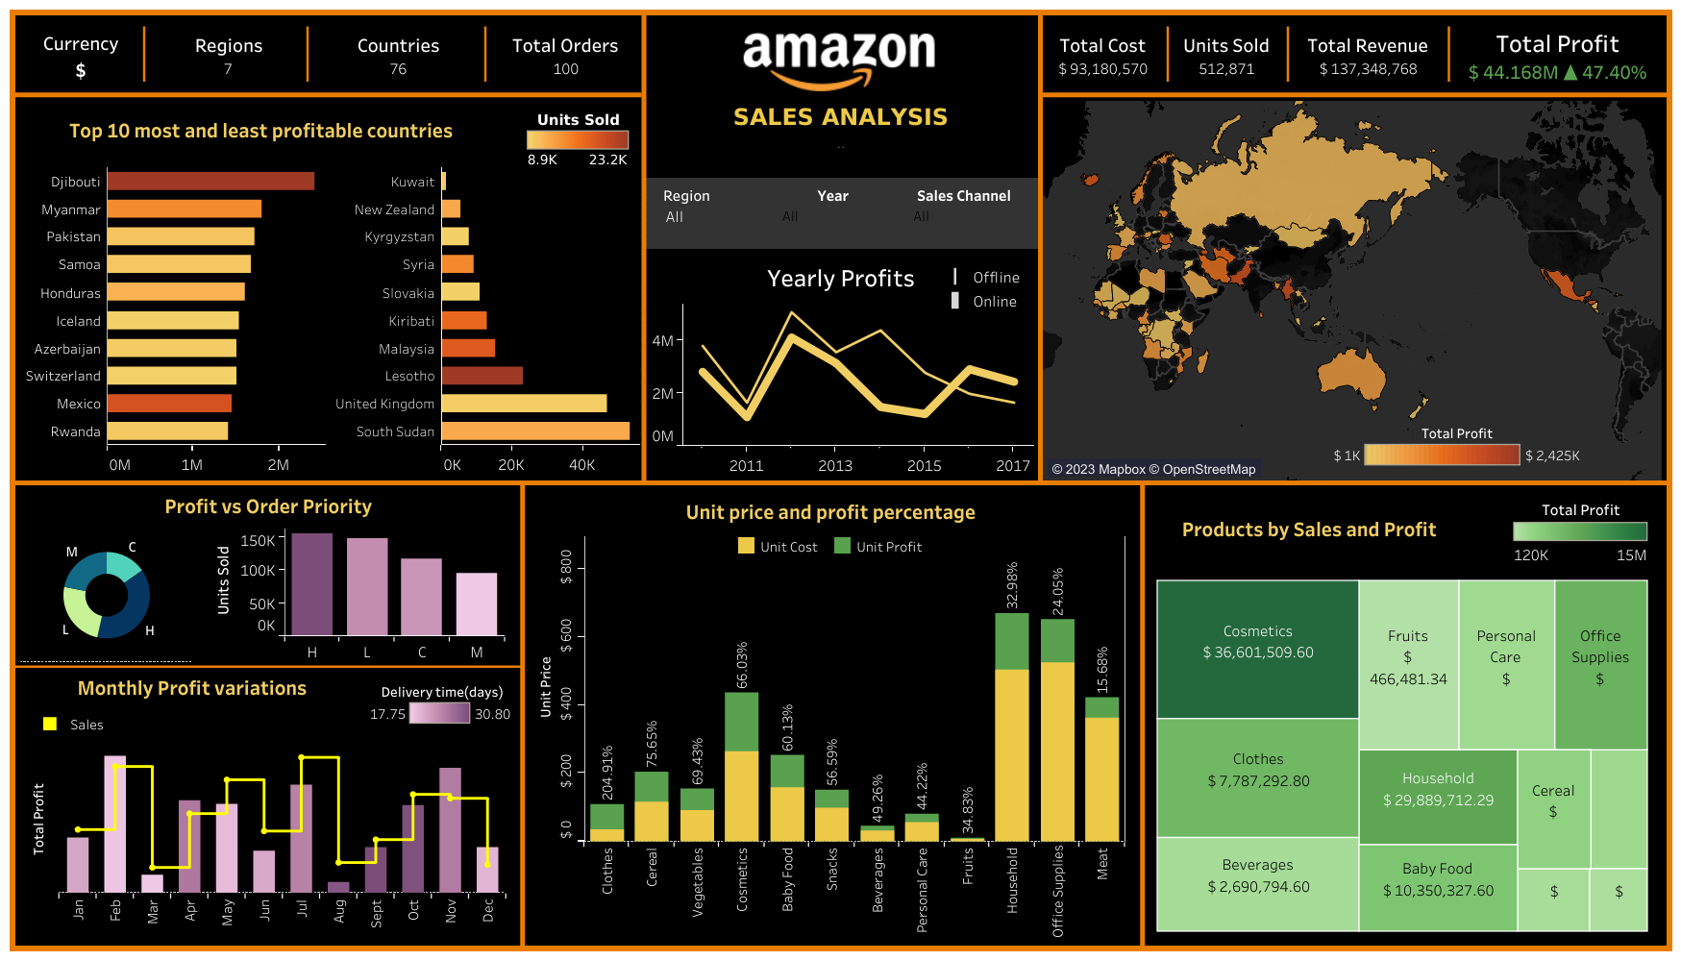
My Design
FINAL DASHBOARD - link

Slide 7
THANK YOU

